Slide 1
Forms
Front-End Web Development

Slide 2
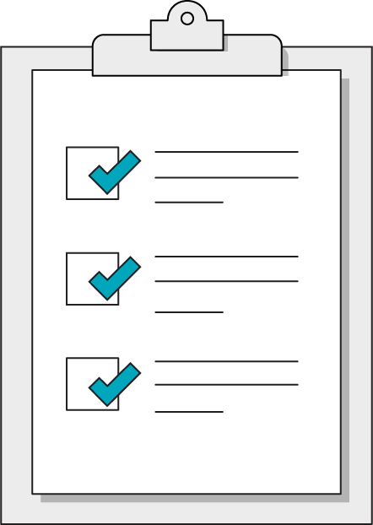
Today’s Learning Objectives
In this lesson, you will:
Use HTML forms to collect input from users.
Respond to form submission events to perform validation checks.
2 | © 2020 General Assembly
Notes:
DURATION: 1 minute
TEACHING TIPS:
Learning objectives help frame the lesson and give students an idea of what to expect and focus on.
Explain to students how this lesson fits into the overall course to help them make connections with content from other lessons.

Slide 3
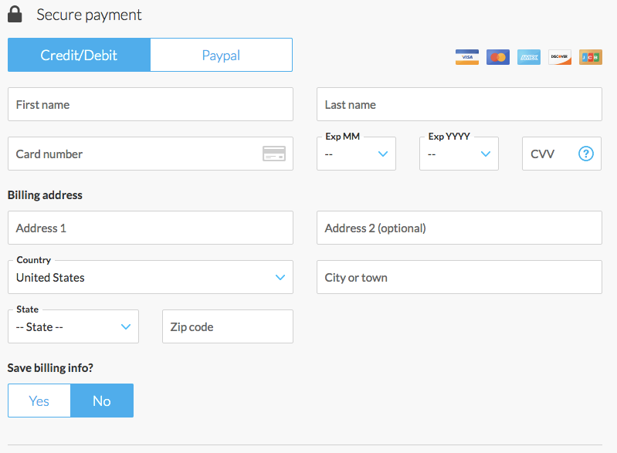
Websites Take on Many Forms...
Notes:
TALKING POINTS:
So far, we’ve looked at interaction from users with a limited amount of possibilities. Either they click something or they don’t. Forms let users perform more complex interactions, allowing them to put in their own data.

Slide 4

What Forms Do
Forms capture user input from the web and typically send it off to the back-end of a website to be processed in some way.
Anytime you enter any content into a webpage, you are using a form!
Notes:
TALKING POINTS:
We’ll look at the API/submissions process in more depth in the next lesson. For now, think of form submissions as the phone calls of the internet.

Slide 5
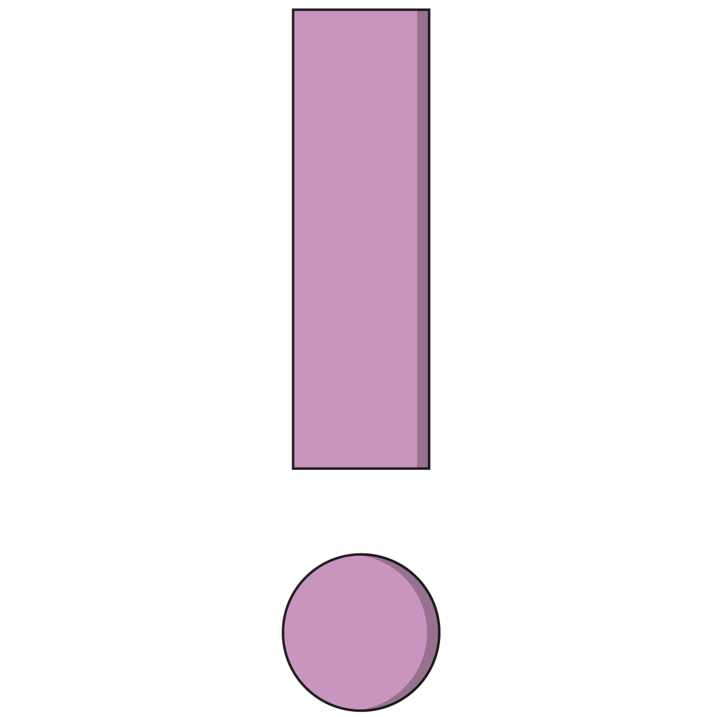
Simplest Form
<form action="/process.php" method="get">
<input type="text">
<input type="submit">
</form>
All forms have the form tag wrapping around them. Always include all components of your form within these tags.
Forms have a lot of markup and are tedious to build.
Notes:
TALKING POINTS:
For instance, normalize.css spends most of its energy taming form inputs. There are also many different styles and patterns of forms out there, so don’t expect a one-true-way of creating forms! Just focus on the essentials: <form>, inputs, and submit.

Slide 6
The Form Element
<form action="/process.php" method="get">
<input type="text">
<input type="submit">
</form>
Action
The action is where the data of the form will be sent (assuming JavaScript is not involved)
Method
This is either “get” or “post” and governs how the browser sends the data to the target listed in the action.
Notes:
TALKING POINTS:

Slide 7
<input>
<form action="/process.php" method="get">
<fieldset>
<legend>Form Title</legend>
<input type="text" id="username">
<input type=”number” id=”age”>
<input type=”submit” value=”Submit this form!”>
</fieldset>
</form>
Notes:
TALKING POINTS:
input is the workhorse of the form world — it can accept many types of user information, depending on the type property it is given.

Slide 8
<label>
<form action="/process.php" method="get">
<fieldset>
<legend>Form Title</legend>
<label for="username">Username:</label>
<input type="text" id="username">
<button type="submit">
</fieldset>
</form>
Notes:
TALKING POINTS:
label is the tag for telling a user what an input represents. The for attribute specifies which form element a label is bound to and uses the element’s id value as its means of making this distinction. The relationship provides some UI features such as moving focus to the relevant input when the label is clicked, tapped, or otherwise triggered.

Slide 9
Ready, <fieldset>, Go!
<form action="/process.php" method="get">
<fieldset>
<input type="text">
<button type="submit">
</fieldset>
</form>
Notes:
TALKING POINTS:
<fieldset> wraps around a set of field inputs on the form. These tags are optional but semantically useful for forms with complex presentation.
Here is a working example of a <fieldset>: https://www.w3schools.com/tags/tag_fieldset.asp

Slide 10
Life of a <legend>
<form action="/process.php" method="get">
<fieldset>
<legend>Form Title</legend>
<input type="text">
<button type="submit">
</fieldset>
</form>
Notes:
TALKING POINTS:
<legend> is where you can put the title of the form or <fieldset>.

Slide 11
Types of Inputs
Front-End Web Development

Slide 12

The Wide, Wide World of Input Types
There’s a huge list of possible input types out there: https://developer.mozilla.org/en-US/docs/Web/HTML/Element/input
Depending on how specific you want to get, the same form question could be represented with several different form inputs.
Once again, the world of programming presents us with a large number of possibilities. Like usual, we’ll focus in on a few of the most important items that will allow us to master the patterns that will show up for all other types of inputs.

Slide 13
text and number Inputs
<form>
<fieldset>
<legend>Form Title</legend>
<input type="text" id="username">
<input type="number" id="age">
<input type="submit" value="Submit this form!">
</fieldset>
</form>
Data gathered with JavaScript from a number input will be in the form of a string! You may have to typecast the value into a number type.
Notes:
TALKING POINTS:
The most common inputs, text and number, are self-explanatory.

Slide 14
<textarea>
<textarea placeholder="Write something here"></textarea>
This creates a really big area of text that users can fill in. Although you may see this done in examples, don't size it with HTML attributes — please use CSS!

Slide 15
<select>
<select id="plays-of-shakespeare">
<optgroup label="Dramas">
<option value=”king-lear”>King Lear</option>
<option value=”hamlet”>Hamlet</option>
</optgroup>
<optgroup label="Comedy">
<option value=”midsummer”>A Midsummer Night’s Dream</option>
<option value=”twelfth-night”>Twelfth Night</option>
</optgroup>
</select>
select is for lists you click on to select an item.
optgroup is optional but useful for grouping related options.
option is an individual value a user can choose from the select list.

Slide 16
Checkboxes
<div class="checkbox">
<input type="checkbox" id="vip-upgrade">
<label for="vip-upgrade">VIP upgrade</label>
</div>
checkbox inputs can either be “on” or “off,” depending on whether the user has clicked them.
You have to put labels after checkboxes for them to make any sense, otherwise they’re just floating squares in your form.

Slide 17
Radio Buttons
<div class="radio">
<input type="radio" id="radio1" name="quality-feedback">
<label for="radio1"><span>Good</span></label>
</div>
<div class="radio">
<input type="radio" id="radio2" name="quality-feedback">
<label for="radio2"><span>Bad</span></label>
</div>
Radio buttons are very similar to checkboxes but function as a group with the name attribute. Users can only choose one option among radio inputs with the same name.

Slide 18
Styling Forms
Front-End Web Development

Slide 19
New CSS Selector: Attributes
input[type=text] {
margin: 25px 0;
}
input[type="text"] {
margin: 25px 0;
}
Notes:
TALKING POINTS:
If you want to target a particular attribute in HTML, use the brackets. The attribute name is on the left, and the specific value we want to target is on the right. Note that this pseudo-selector could use any HTML attribute, not just type!

Slide 20
:focus
textarea:focus {
outline: none;
}
There may be cases where you want to style what it looks like when a user is active on a field. To do so, use the :focus pseudo-selector.
Notes:
TEACHING TIPS:
Ask: Does this pseudo-selector remind you of anything we’ve seen before?
Answer: This should remind students of :hover from the animations lesson. A good point to remind them of is that, in web development, patterns are more useful than memorizing individual details.

Slide 21

Styling Notes
Don’t
Do
Style the text boxes, checkboxes, and radio buttons themselves. You can do this, but the techniques will drive you crazy.
Clutter the form with too many images or animations. Forms are supposed to make interactions with web applications simple and clear.
Put effort into styling valid vs. invalid form submission states. Help your users by clearly communicating when a form is invalid and which fields need to be fixed.

Slide 22
Building & Styling A Form
Let’s use this form as an example for responding to a form submission:
22 | © 2020 General Assembly
Notes:
TEACHING TIPS:
Walk through the steps in the following slides in this CodePen, showing the process of stopping the form submission from firing, reading the information from the first field or two, and then appending an error message/clearing previous error messages.

Slide 23
Forms & Frameworks
Front-End Web Development

Slide 24
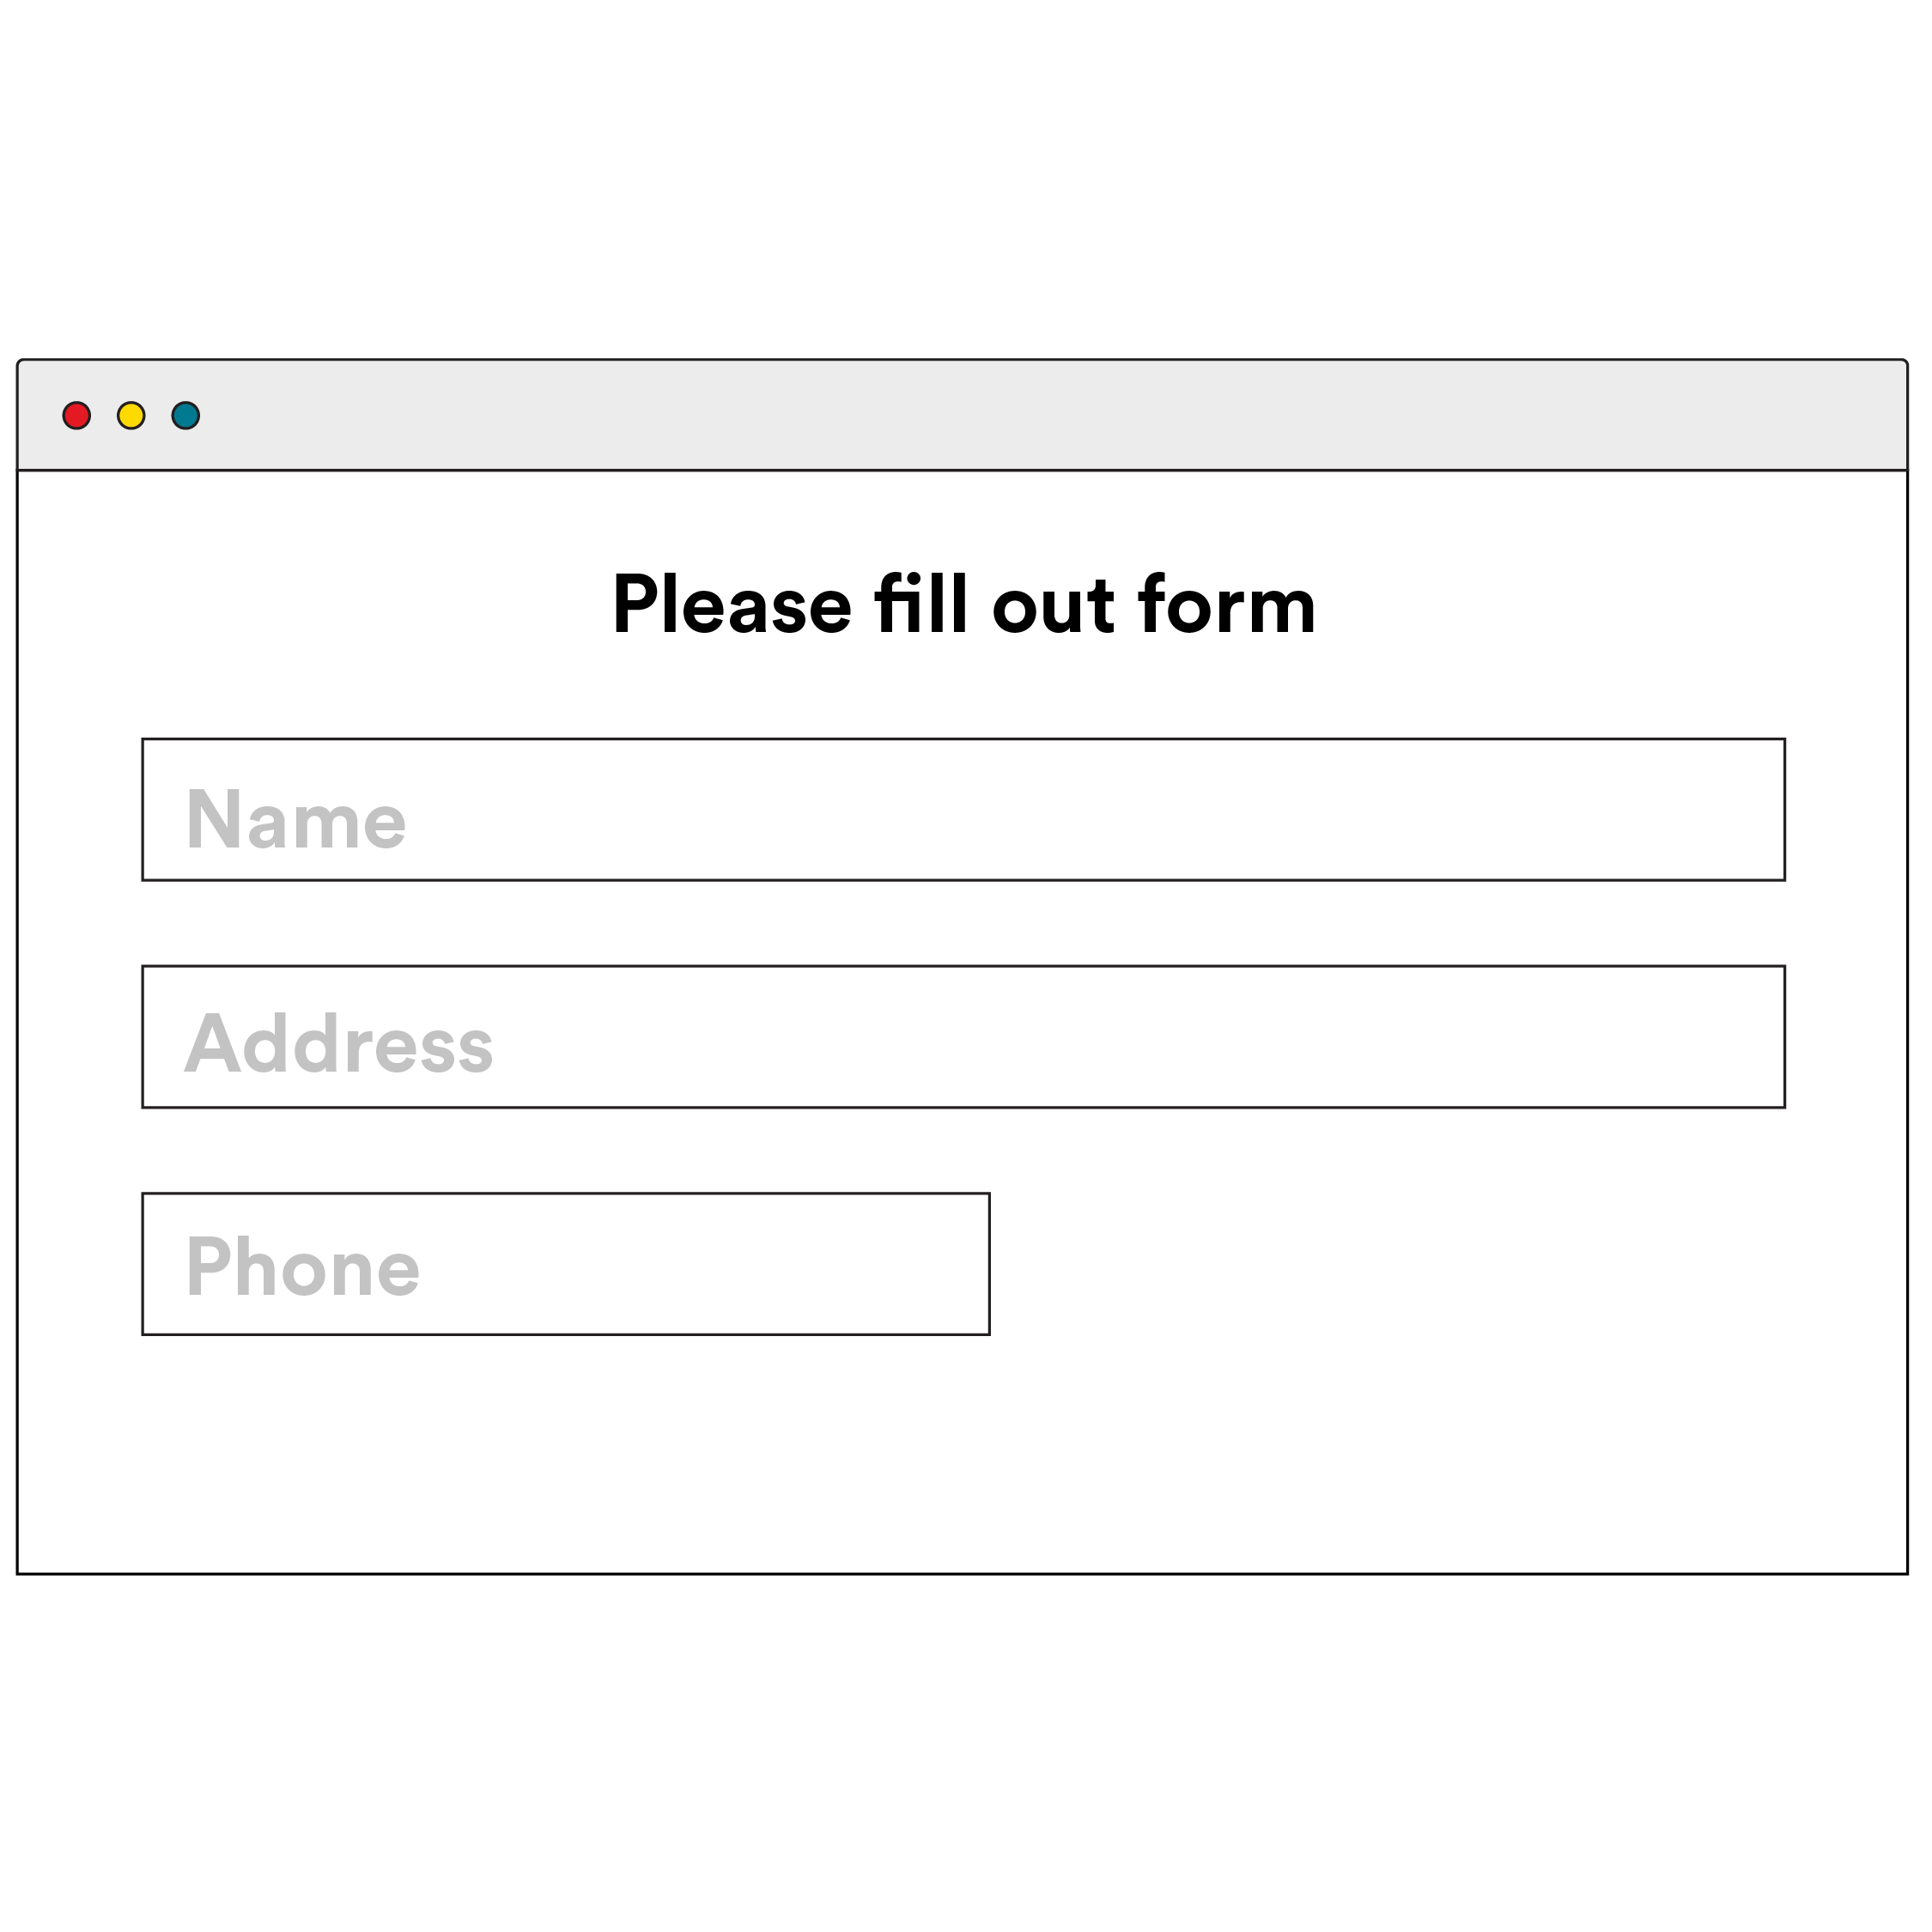
Frameworks Make Forms Easier
Frameworks provide:
Pre-styled form elements.
Better layout combinations
Small style helpers
Responsive form layout
24 | © 2020 General Assembly

Slide 25
Forms with Bootstrap
Let’s use this form as an example for responding to a form submission:
25 | © 2020 General Assembly
Notes:
TEACHING TIPS:
Walk through the steps in the following slides in this CodePen, showing the process of stopping the form submission from firing, reading the information from the first field or two, and then appending an error message/clearing previous error messages.

Slide 26
Key Takeaways
For Next Time
Forms Power User Interaction
APIs
Forms have many types of inputs.
CSS attribute selectors can target specific types of inputs.
We can respond to form submissions using event listeners.
We’ll use forms to collect data from users and use that data to make requests to other servers.
Our apps will finally interact with other members of the internet community: APIs!
26 | © 2020 General Assembly

